Slide 1
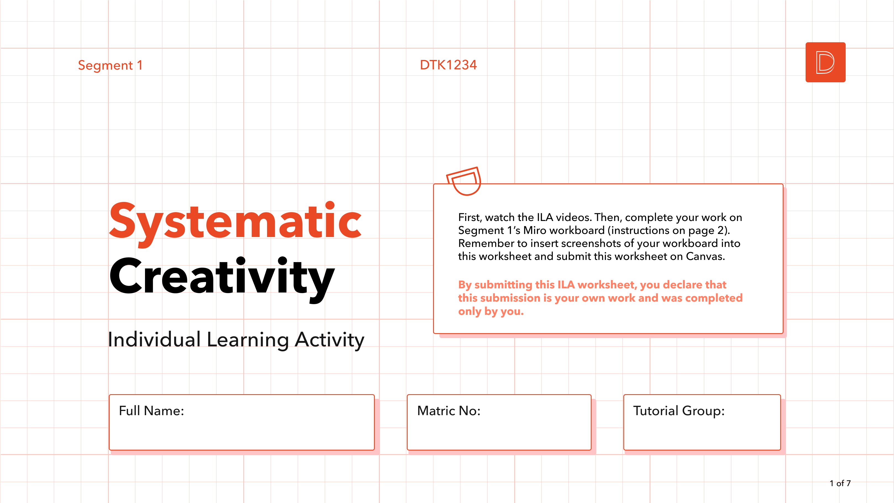
Moon Ji Hoon
A0255555X
TO23

Slide 2
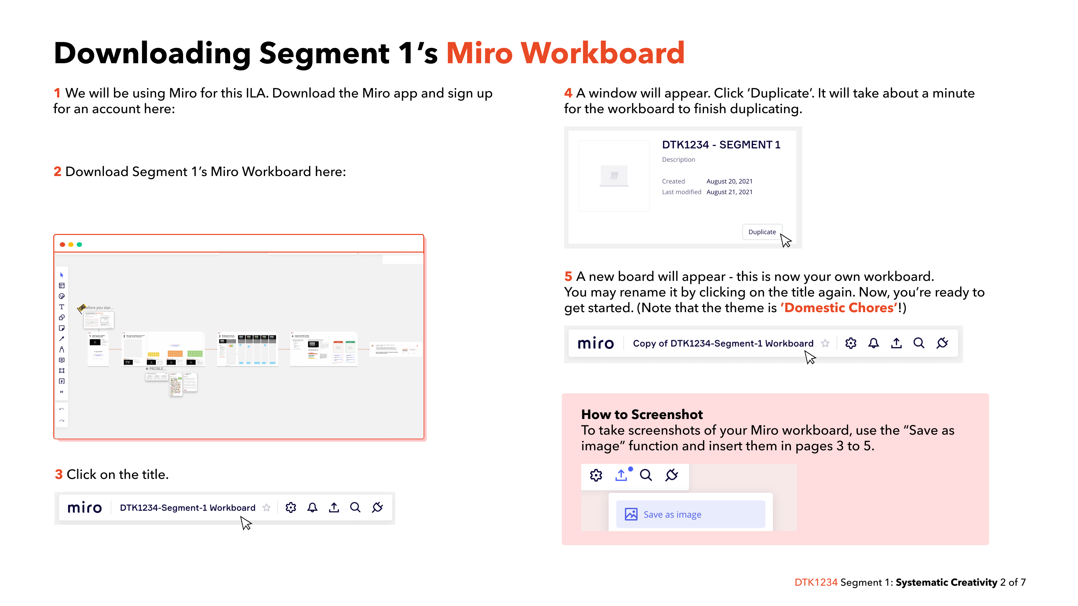
https://miro.com/apps/
https://miro.com/app/board/uXjVOnGgCRo=/?share_link_id=817698843704
Notes:
https://miro.com/apps/
https://miro.com/app/board/uXjVOnGgCRo=/?share_link_id=817698843704

Slide 3
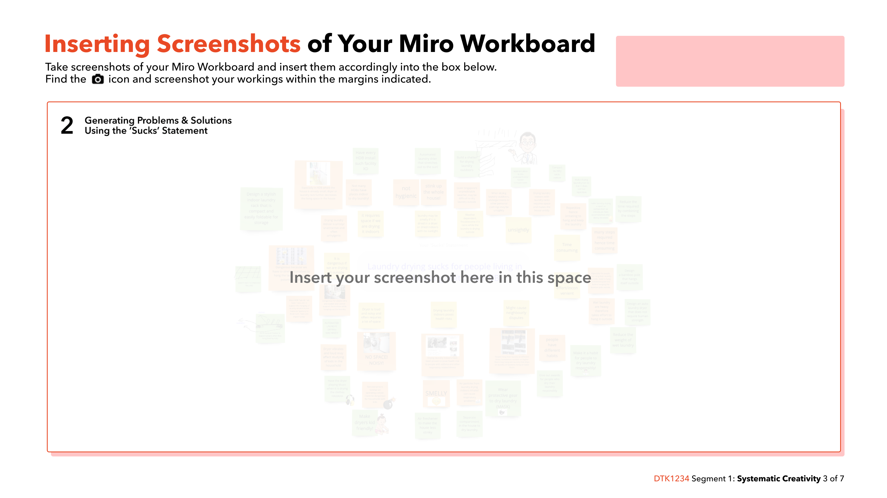
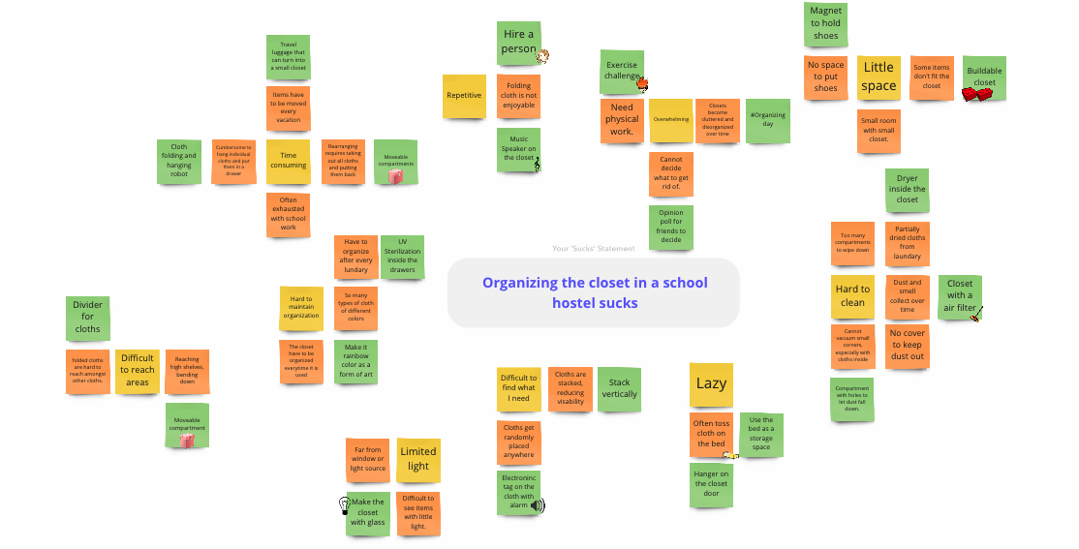
https://miro.com/app/board/uXjVPrB_0to=/?share_link_id=9147890820

Slide 4
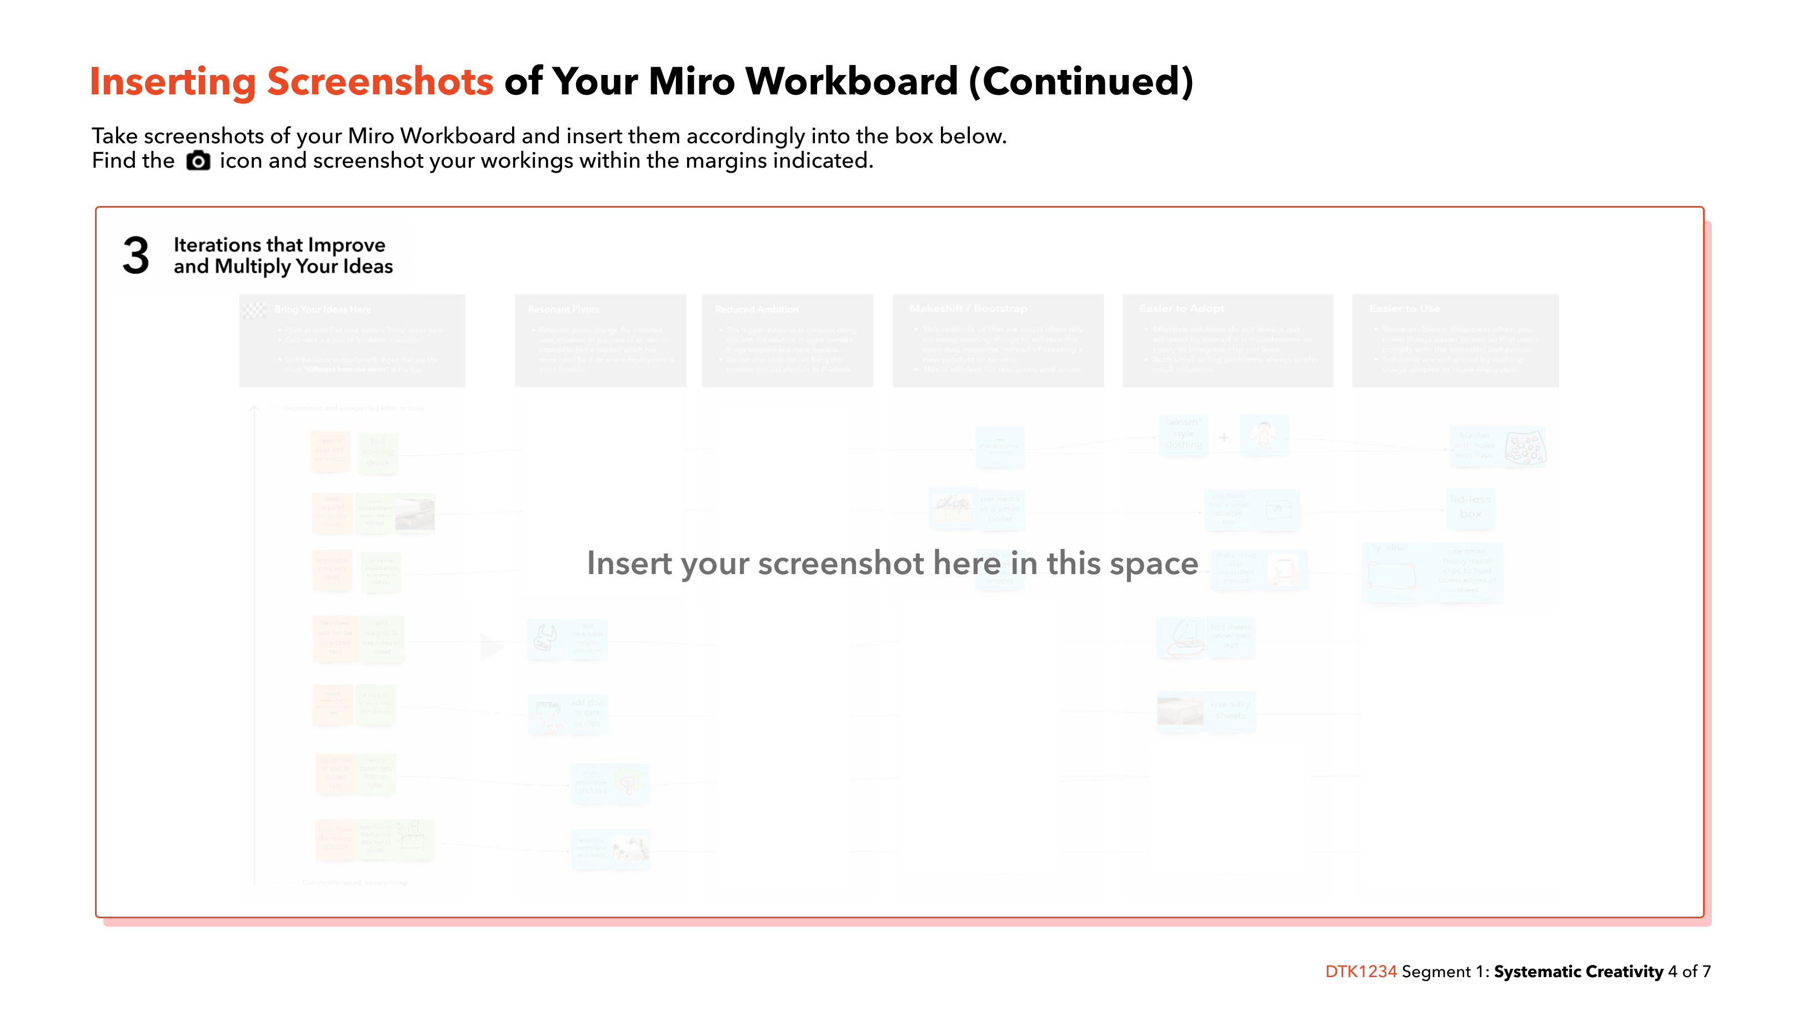
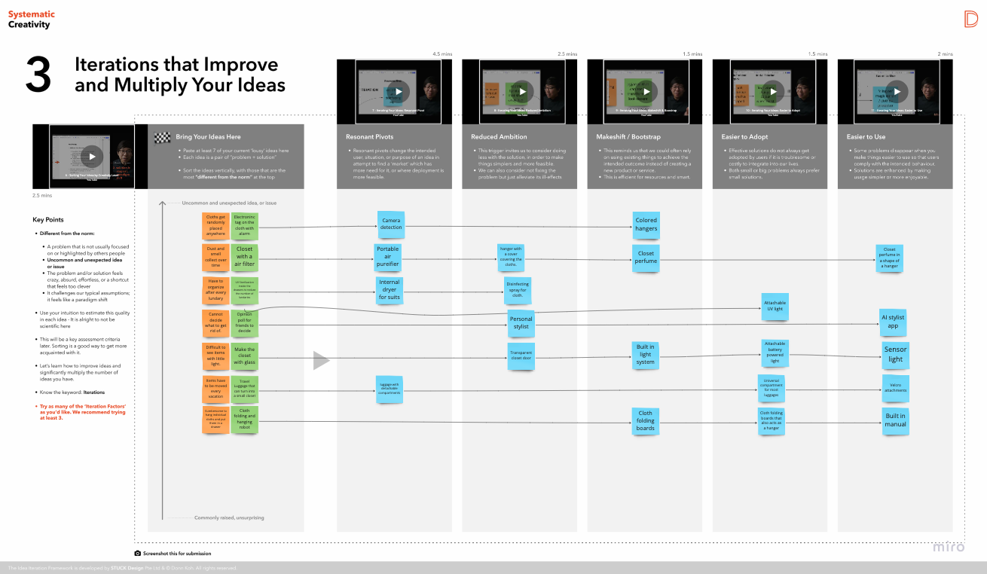

Slide 5
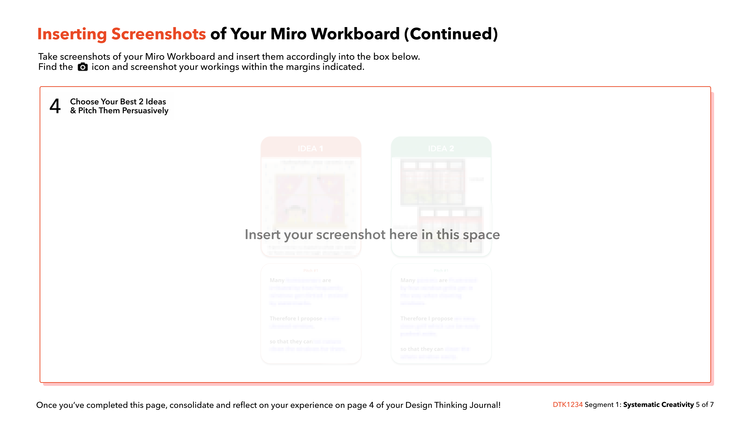
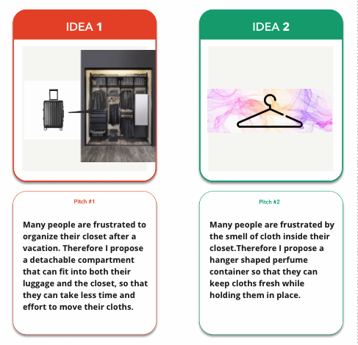

Slide 6
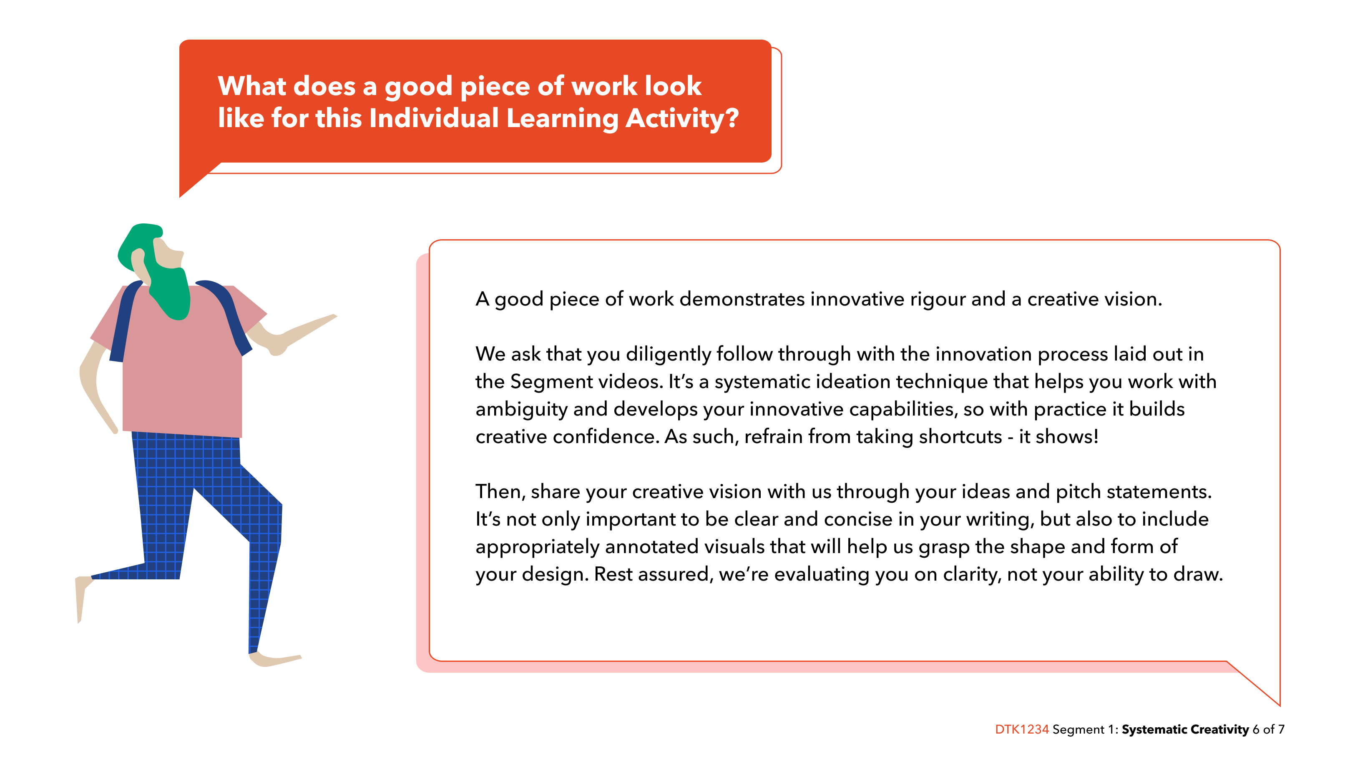

Slide 7
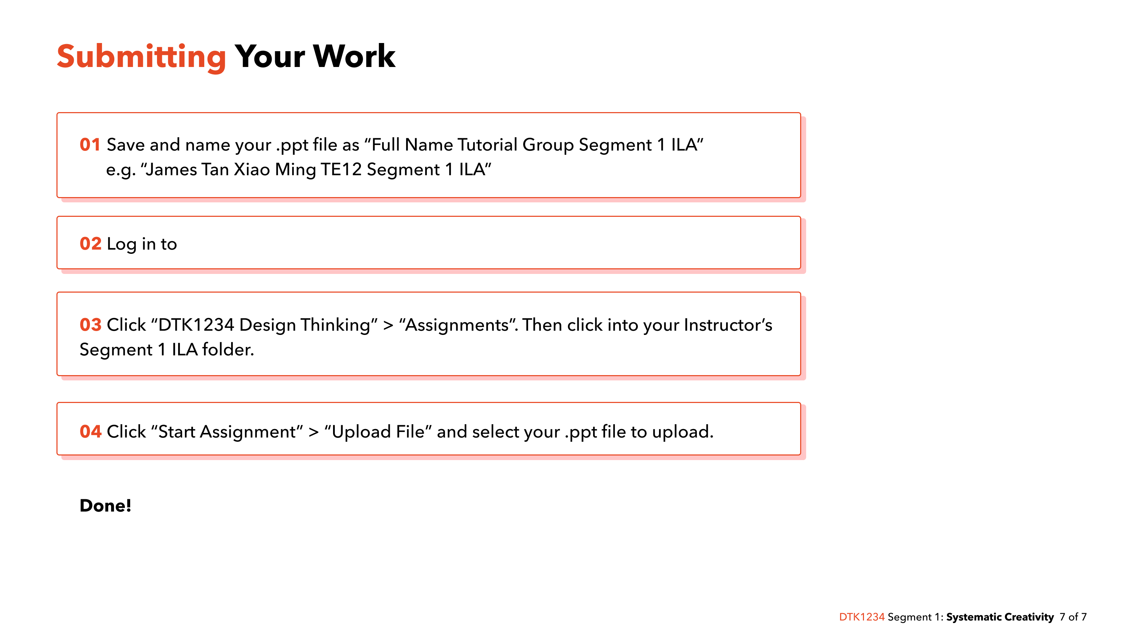
https://canvas.nus.edu.sg
Notes:
https://canvas.nus.edu.sg/

